Slide 1
Mu Sigma capabilities in Life Sciences

Slide 2
A leading pharmaceutical client wanted to optimally allocate spends to various promotional channels in order to maximize revenue
Case Study: Market Mix
There is a need to isolate the impact of channels and understand optimal budgeting scenarios
DTC is allocated at national level and impact is needed at physician level
Many non-promotional factors affect sales
Client is among the top five drug manufacturers in US and markets a Diabetes blockbuster drug through various promotional channels
Diabetes brand team wanted to assess the importance of each promotional channel that significantly impact revenue
They want to optimally allocate promotional spends in order to realize maximum revenue
Outcome: Brand team is able to maximize prescription volume through optimal utilization of promotional spends
Behavior: Brand team has deployed the recommended optimal budget across sales force, DTC and CCM channels
Insight: Understanding of the impact and contributions of promotional channels on product sales
How to isolate the impact of individual channels on the prescription volume?

Slide 3
Understanding key hypotheses and interconnections with other problems helped in coming up with a holistic market mix approach
Case Study: Market Mix
Brand forecast
Budget
Sales Force Sizing
Brand planning
Alignment & Call plan
Responsiveness
Sales Force Planning
Physician access
Sampling
Physician segmentation
Value
Payer access status
Market Access
Market Mix Optimization
CCM Design
Payer control on physicians

Slide 4
An end-to-end market mix study was conducted with key considerations on non-promotional effects
Case Study: Market Mix
Analytical Approach
Customer Segmentation
Customer Segment Validation
Market Mix Modelling
Promotional Channel Contribution
Response Analysis
Optimization & Scenario building
Perform Customer segmentation based on their responsiveness to various promotional channels during the analysis period, grouping customers into homogeneous clusters
Exploratory analysis is done on the customer segments and segment definition is validated by finding average historical promotional touches across various segments
Modelling is done at customer segment level to obtain the estimates of baseline revenue, and other promotional channels - Details, samples, Direct Mails & other media promotions)
Contribution of each promotional channel to total revenue is estimated at segment level
Response analysis is performed by promotional channel and evaluated to identify optimal level and frequency of promotion
Optimal budget allocation at segment level is performed and multiple resource allocation scenarios are evaluated
Key Considerations
Different physicians have different degrees of responsiveness and vulnerability to restricted access of the drug
Some physicians are not accessible by sales reps and can only be reached by CCM
Promotions are known to have interaction effect
There is a constraint of overall promotional budget

Slide 5
Mu Sigma’s integrated marketing mix platform, muMixTM enabled end-to-end process of promotional mix budget planning
Case Study: Market Mix
Analytical Framework
Latent class segmentation technique is used for segmentation of 150k customers into 5 homogeneous clusters based on their responsiveness to personal and non-personal promotions
A multiplicative market mix model was developed using muMixTM platform for each customer segments using detailing, sampling and different promotional media drivers
Ad-stock was computed based on the decay rate of corresponding promotional variables to account for lag effects
The model results are used to develop response curves for each promotional variable at segment level and relative response to each channel is evaluated
Optimized budgets are recommended as a result of optimization exercise performed for each segment through muMixTM Optimization engine, followed by scenario planning using muMixTM planner
Baseline
Sales
Incremental sales due to various promotional activities
log_{e}(Product TRx +1) = β₀ +β₁(Spec) + + β2(log_{e}(Managed Care+1)) + β2(log_{e}(No See flag +1))
β4(log_{e}(PDE+1)) + β5(log_{e}(Sample+1)) + β6(log_{e}(Media Promotions+1)) + β7(log_{e}(Direct Mail+1)) + β8(log_{e}(Email Mail+1)) + β9(log_{e}(Digital+1))

Slide 6
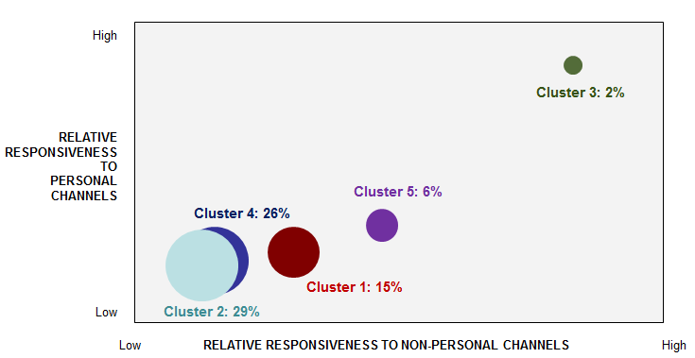
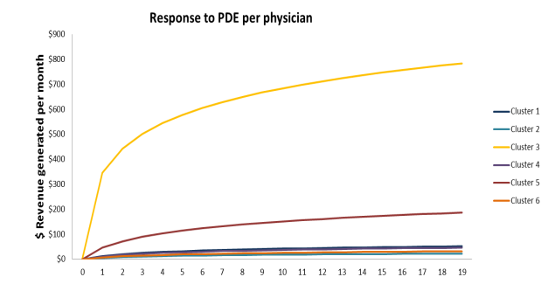
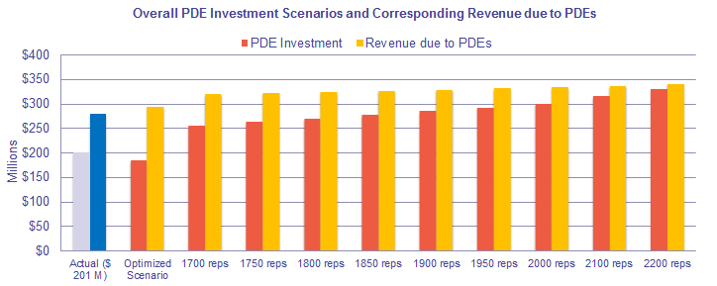
Key insights and recommendations from the analysis helped client improve their allocation strategy and plan the yearly budget
Case Study: Market Mix
Analysis & Results
Key Findings & Insights
The analysis showcased that overall profitability could be increased by allocating more budget to high responsive segments instead of allocating purely by value
With the reduction of sales force efforts and ensuring full capacity utilization of sales force, both profitability and revenue could be enhanced
Segments with varied degree of promotional response were identified
Mixed model for each of the segments helped in creating response curves to identify optimized budget
Business Impact
Client was able to optimally allocate promotional spend across channels as part of annual budget cycle
Client revised existing call and sample allocations by allocating higher efforts to responsive segments, resulting in a projected incremental sales upwards of $100 MM
Further efficiencies were gained by allocating resources to segments that are likely to respond to various digital media tactics
Multiple budget scenarios depicted the minimal revenue gain even with significant increase in budget

